Slide 1
Buffer Overflow
Mrs. Arti Deshpande
TSEC

Slide 2
Types of Flaws
Validation error (incomplete or inconsistent): permissions checks
Domain error: controlled access to data
Serialization and aliasing: program flow order
Inadequate identification and authentication: basis for authorization
Boundary condition violation: failure on first or last case
Other exploitable logic errors

Slide 3
Unexpected Behavior
Unexpected behavior is a program security flaw.
Does the program behave as it was designed?
Behavior can be:
  Vulnerability (class of fault)
  Flaw (fault or failure)
Flaw (human)
  Inadvertent
  Intentional

Slide 4
Buffer overflows
The single most commonly exploited type of security flaw
Simple example:
#define LINELEN 1024
char buffer[LINELEN];
gets(buffer);
or
strcpy(buffer, argv[1]);

Slide 5
What's the problem?
The gets and strcpy functions don't check that the string they're copying into the buffer will fit in the buffer!
Some languages would give you some kind of exception here, and crash the program.
Not C (the most commonly used language for systems programming). C doesn't even notice something bad happened, and continues on its merry way.

Slide 6
Smashing The Stack For Fun And Profit
This is a classic exposition of how buffer overflow attacks work.
if the attacker can write data past the end of an array on the stack, she can usually overwrite things like the saved return address. When the function returns, it will jump to any address of her choosing.
Targets: programs on a local machine that run with setuid (superuser) privileges, or network daemons on a remote machine

Slide 7
Kinds of buffer overflows
In addition to the classic attack which overflows a buffer on the stack to jump to shellcode, there are many variants:
  Attacks which work when a single byte can be written past the end of the buffer (often caused by a common off-by-one error)
  Overflows of buffers on the heap instead of the stack
  Jump to other parts of the program, or parts of standard libraries, instead of shellcode

Slide 8
Defences against buffer overflows
How might one protect against buffer overflows?
Use a language with bounds checking
  And catch those exceptions!
Non-executable stack
Stack (and sometimes code) at random addresses for each process
  Linux 2.6 does this
“Canaries” that detect if the stack has been overwritten before the return from each function
  This is a compiler feature

Slide 9
Nonmalicious Program Errors
Buffer Overflows
  Excess information provided – overfilling the bucket
  Buffer – space in which data is held (array or string)
  char sample[10] or char sample[i]
  For (i=0; I<=9; i++)
  sample[i] = ‘A’;
  sample[10] = ‘B’;

Slide 10
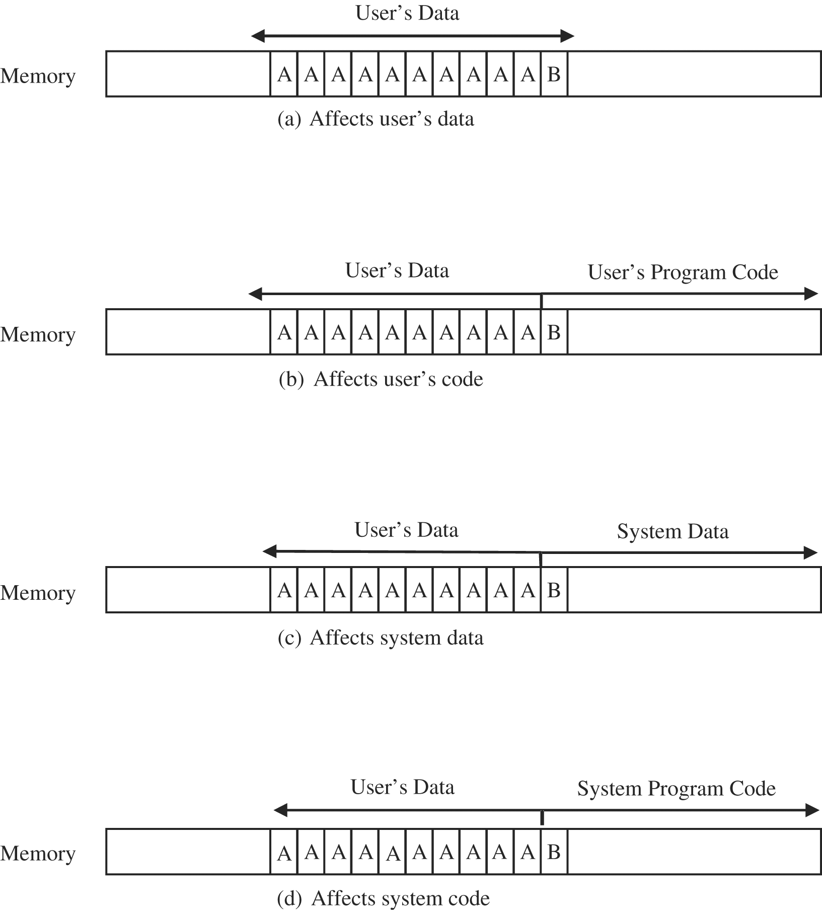
Figure 3-1 Places Where a Buffer Can Overflow.

Slide 11
Buffer overflows
One of the most common vulnerabilities in software
Particularly problematic when present in system libraries and other code that runs with high execution privileges.

Slide 12
How it works
Application reserves adjacent memory locations (buffer) to store arguments to a function, or variable values.
Attacker gives an argument too long to fit in the buffer.
The application copies the whole argument, overflowing the buffer and overwriting memory space.
If the conditions are “just right” this will enable to attacker to gain control over the program flow and execute arbitrary code, with the same privileges of the original application.

Slide 13
Stack smashing
<previous stack frame>
function arguments
Function (sub-routine) calls results in an activation frame being pushed onto a memory area called the stack.
return address
previous frame pointer
local variables
local buffer variables
Direction of stack growth

Slide 14
Memory management
Stack
Direction of stack growth
The stack, which contains activation frames, starts at the highest memory address allocated for the process, and grows downwards
Variable-length data (e.g., strings) that are read dynamically, are kept in the heap, which grows upwards
This arrangement maximizes flexibility of virtual memory management
Direction of heap growth
Heap
unitialized variables
initialized variables
code instructions

Slide 15
How to smash
<previous stack frame>
Give application a very long string with malicious code
The string length, being much larger than the space allocated in the heap (buffer size declaration) causes the heap to overflow into the stack and overwrites the return address
The return address now points to the beginning of the malicious code
function arguments
Return address (overwritten with entry address of malicious code)
Previous frame pointer (overwritten w/ malicious code)
local variables (overwritten w/ malicious code)
local buffer variables (overwritten w/ malicious code)
Direction of stack growth

Slide 16
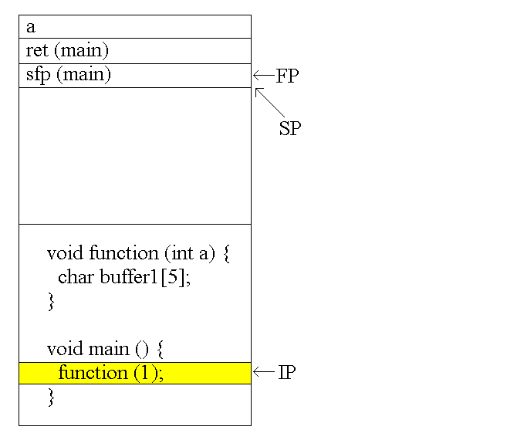
Function Calls

Slide 17
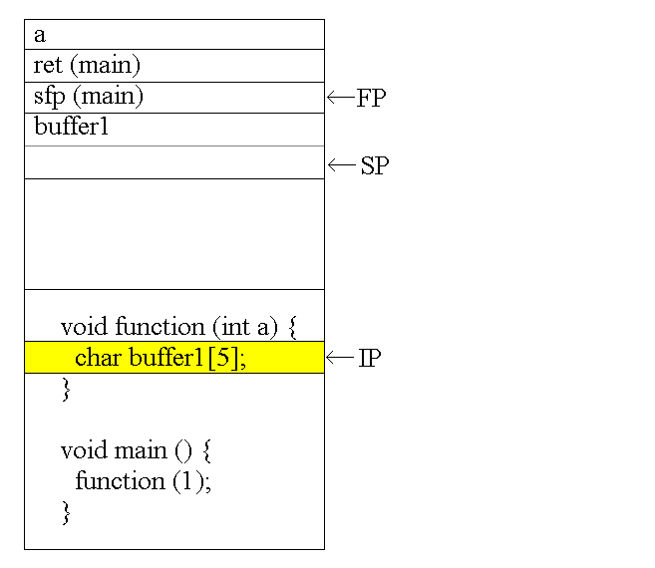
Function Calls

Slide 18
Buffer Overflows
void function(char *str) {
char buffer[8];
strcpy(buffer,str); }
void main() {
char large_string[256];
int i;
for( i = 0; i < 255; i++)
large_string[i] = 'A'; function(large_string); }

Slide 19
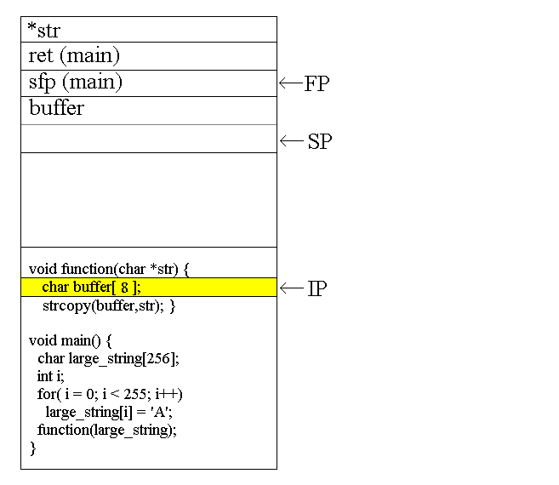
Buffer Overflows

Slide 20
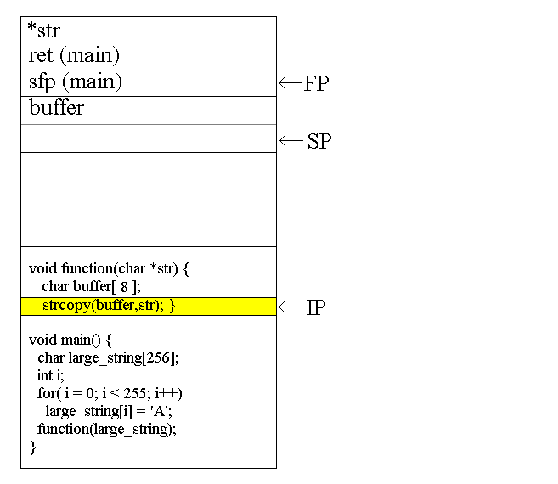
Buffer Overflows

Slide 21
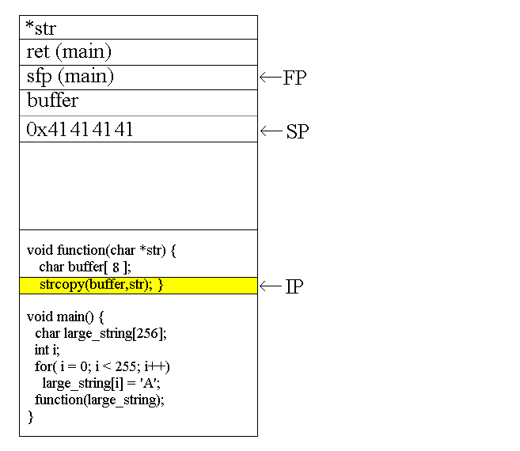
Buffer Overflows

Slide 22

Buffer Overflows

Slide 23
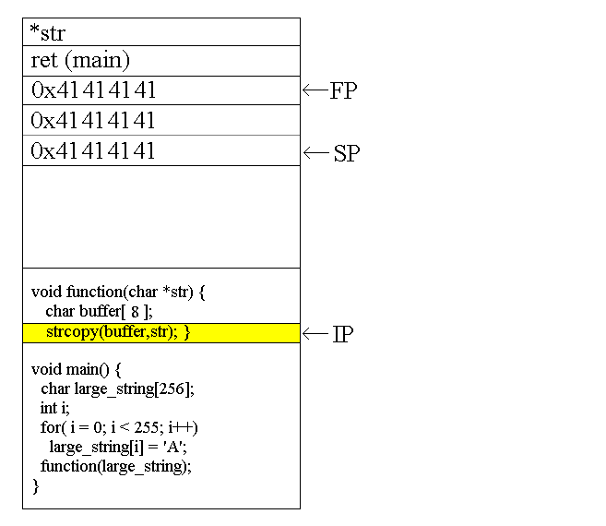
Buffer Overflows

Slide 24
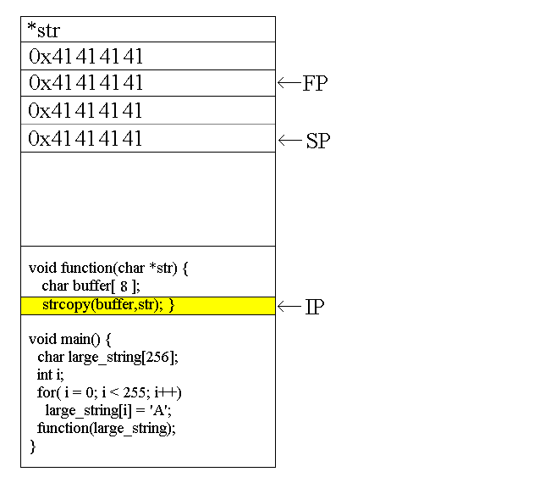
Buffer Overflows

Slide 25
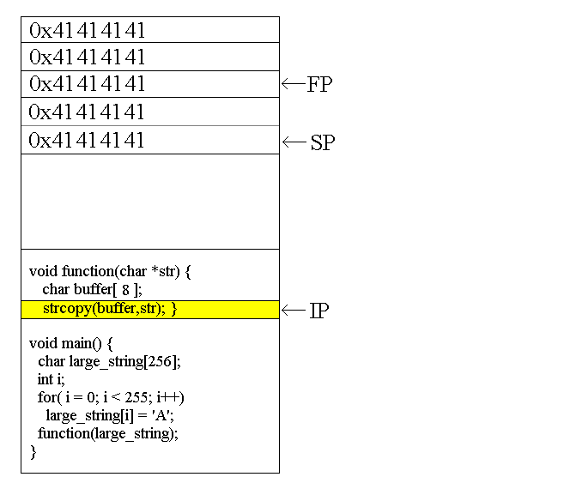
Buffer Overflows

Slide 26
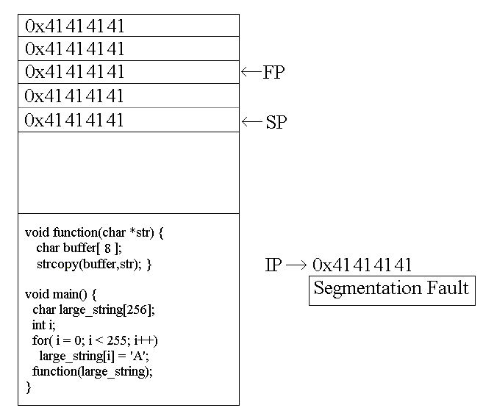
Buffer Overflows

Slide 27
Buffer Overflow Defenses
This presents some examples, pros, and cons of various defenses against buffer overflows.
Caveats:
  1. This is not intended to be a complete list of products that defend against buffer overflows.
  2. There is no silver bullet that will stamp out buffer overflows, but some of these tools may help.

Slide 28
Kinds of Defenses
Better software engineering practices
Find-and-patch methods
Language tools
Analysis tools
Compiler tools
Operating system tools

